Slide 1
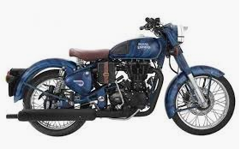

Capstone Project
Vivek Kumar Sharma 19020448058
Ruparam Choudhary 19020448068
Rohit Kawedia 19020448077
Harish Sakharkar 19020448082
Ranjit Bhalkar 19020448083
Bhavana Madhani 19020448101
Utkarsha Kurekar 19020448107
Swati Dhar 19020448108
Shirish Kotkar 19020448114
ZOOM MOTROS – ARROW Bikes

Slide 2
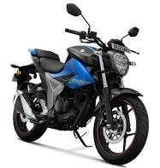
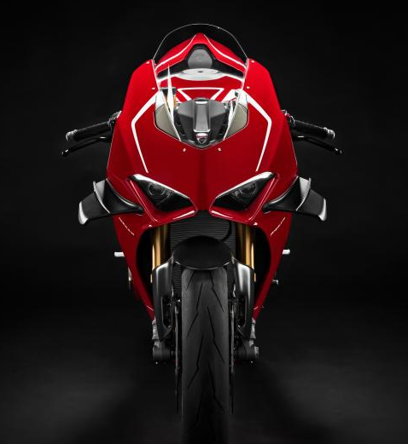
Company History and Product Portfolio
Zoom Arrow Bikes
Export - North America, Europe, Africa & South America
2020-23
2008
2009
2010
2012
2013
2014
2015
2016
2017
2018
India - Domestic
Domestic - India
 | Low HP Bikes | High HP Bikes
Total Sale Qty. 2019 | 100 | 200
Engine HP | 100 | 500
Length (mm) | 2090
Weight (Kg) | 171
Total Sales 2019 | $1264 Millions
Expected Growth | 9% YOY

Slide 3
Company Growth Plan
US is potential market for customized High HP models with 5% Growth YOY
Europe market is for High HP models with 5% Growth YOY
Africa is great market for Low HP model expecting 15% growth
India is saturated market and expecting only 3% growth
Ref – Excel for Growth assumption,

Slide 4
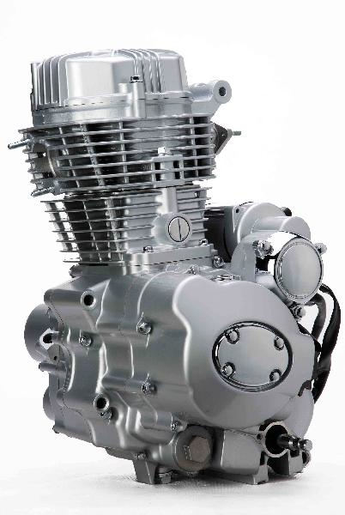
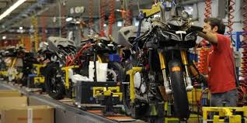
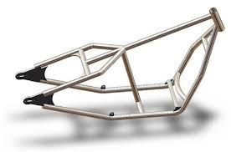
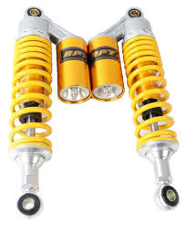
Current Manufacturing model
Supplier Base
Manufacturing plant
Region
City
Assembly, Painting and testing
North America
Denvar
Engine Assly - Subsidiary of Zoom - Bangalore
Location – Bangalore, India
Europe
Italy
Chassis-
M/s Kanti fabrications
Bangalore
South Africa &
America
TBD
Shock absorber – Tech- Hosur – Bangalore
India
All States
Other parts (Hardware)
Chennai and Maharashtra

Slide 5
Issue / Challenges and VOC
Challenges and Concerns
Issue Parreto’s |  | Category | Action Plan
1 | Frame dimensions issue | Quality | Q1 2020
2 | Shock absorber performance | Quality | Q1 2020
3 | Frame Supplier OTD performance | OTD | Q1 2020
4 | Lead time for USA | OTD/ CELT | Q1 & Q2 2020
5 | Lead time for Europe | OTD/ CELT | Q1 & Q2 2020
6 | Distribution channel and Price competition for Africa | Cost and Distribution | Q2 2020
7 | Distribution channel for India | OTD | Q2 2020
8 | Logistics Packaging issue | Quality | Q1 2020
9 | Spare Part availability for US and Europe | Distribution | Q2 2020
10 | India Operation Challenges | Operation and Systems | Q1 & Q2 2020
Priority 1, 2 and 3 addresses issues in Supply chain set up and Supplier Quality and Delivery issues
Priority 4 is Operations issues which consist of system and skills issues
Ref

Slide 6
Issue 1 & 2 –Body Frames & Shock absorber Quality issues
Body Frames
Shock Absorber Quality issues
Actions | Frequency | Who | When
Quality audit of M/s Kanti fabrications | Monthly | Zoom Supplier Quality Manager | 16th Jan 2020
100% dimensional inspection at supplier end | Each piece | Supplier Quality manager | 1st Feb 2020
Functional test on random sample | Monthly | Supplier Quality manager | Feb 2020
Training to supplier manufacturing quality team | Yearly | Zoom Supplier Quality Manager | 16th Feb 2020
Actions | Frequency | Who | When
Quality audit of Spring Supplier | Monthly | Zoom Supplier Quality Manager | 16th Jan 2020
100% dimensional inspection at supplier end | Each piece | Supplier Quality manager | 1st Feb 2020
Reliability testing's from batch of springs | Monthly | Supplier Quality manager | Feb 2020
Training to supplier manufacturing quality team | Yearly | Zoom Supplier Quality Manager | 16th Feb 2020
Quality is prime for business to grow in competitive market, the regular cadence with suppliers for Quality norms will help in achieving Organizational goal that’s “100% First Pass Yield and Customer Expected Lead Time with no Delays”
Ref

Slide 7
Issue 3 – Body Frames On Time Delivery
Short Term Strategy
Long Term Strategy
Body Frames - M/S Kantilal Fabrications
Second Supplier for Body Frames
Actions | Frequency | Who | When
Set up 2 Kanban Super Markets for Low & High HP at Supplier end for stock of 10 days requirements | Monthly | Zoom Supply chain Head | 1st Feb 2020
Integrate Suppliers with company SAP system for inventory control | NA | Zoom Supply chain Head | 15th Feb 2020
Enforce LD’s for not meeting the daily stocks and line stoppages due to unavailability of body frames | Daily | Supply chain manager | Feb 2020
Actions | Frequency | Who | When
Identify second supplier close to Factory |  | Zoom Supply chain leader | 30th Jan 2020
Audit of Supplier for selection and Negotiation |  | Supplier Quality manager | 20th Feb 2020
Integrate supplier with SAP |  | Zoom Supply chain Head | 30th Mar 2020
Pilot Run |  | Zoom Supplier Quality, Operations Manager | 15th June 2020
Stocking Model and Push supply chain for Body to improve CELT
De-risk the Supplier monopoly by introducing second supplier, Stocking Model and Push supply chain for Body to improve CELT
Ref

Slide 8
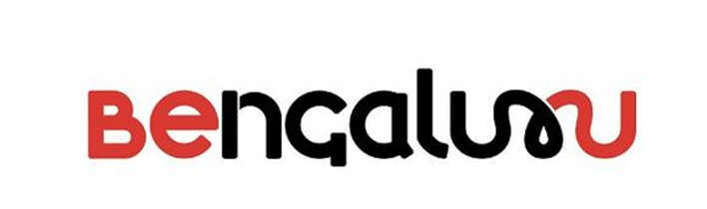
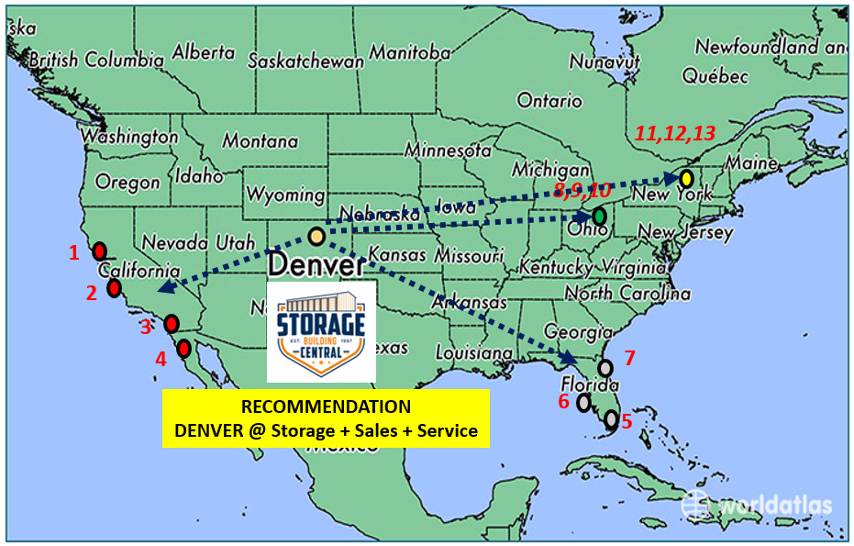
Issue 4 North America – CELT
Product – High HP Customized Bikes with <4 weeks Lead time
Short Term Strategy
RECOMMENDATION
TARGET CITIES / CUSTOMERS
Supply Chain Model
Push to Wearhouse at Denver and
Pull to meet CELT of <4 weeks
Chennai India to Long Beach CA Port by Sea needs 2 weeks
Pros and Cons:
Max lead time of 3 days for delivery to customer, increase market share
Cost of Customization is very high ~$125 (approx. 2.5 hours per bike for Customization)
Inventory carrying cost will be high ~
CALIFORNIA
San Francisco
San Jose
Los Angeles
San Diego
CELT < 24 hrs.
FLORIDA
Miami
St Petersburg
Orlando
CELT < 30 hrs.
Denver
Actions | Who | When
Establish Central Wear House with small modifications at Denver | Supply Chain Head & Operations Head | 30th Jan 2020
Establish dealers at 4 Identified states | Supply Chain Head | 30th Jan 2020
Contract with Road transporters for full load containers | Supply Chain Head | 10th Feb 2020
Identify mod shop at Denver and training for modifications | Supply Chain and Operations | 15th Feb 2020
CELT < 18 hrs.
OHIO
Columbus
Cleveland
Cincinnati
CELT < 28 hrs.
New York
New York
Buffalo
Rochester
Ref - https://www.statista.com/topics/1305/motorcycles-in-the-us/

Slide 9
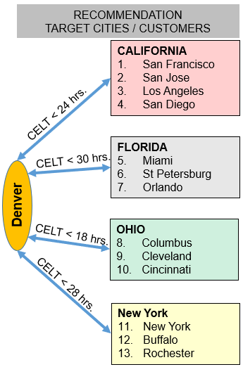
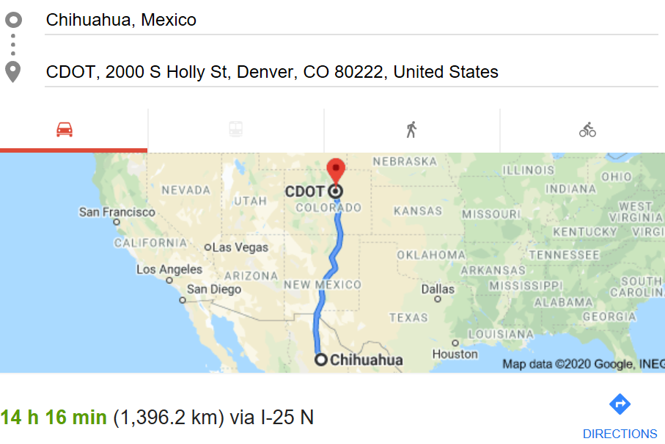
Issue 4 North America – CELT
Product – High HP Customized Bikes with <4 weeks Lead time
Long Term Strategy – Option 1
Manufacturing Plant Mexico,
Supply chain
Frames, Shock absorbers and Other Hardware Items supply chain at Mexico
Engine supply chain at Chennai / Pune India
Supply Chain Model
Push to Wearhouse at Denver and
Pull to meet CELT of <4 weeks
Chennai India to Long Beach CA Port by Sea needs 2 weeks
Pros and Cons:
Max lead time of 3 days for delivery to customer, increase market share
Cost of Customization is very high ~$125 (approx. 2.5 hours per bike for Customization)
Inventory carrying cost will be high ~
High HP Bikes
Mexico
Body Frames,
Shock absorber
And other Hardware
By Road
Mexico
Mfg. Plant
Actions | Who | When
Establish Central Wear House with small modifications at Denver | Supply Chain Head & Operations Head | 30th Jan 2020
Establish dealers at 4 Identified states | Supply Chain Head | 30th Jan 2020
Contract with Road transporters for full load containers | Supply Chain Head | 10th Feb 2020
Identify mod shop at Denver and training for modifications | Supply Chain and Operations | 15th Feb 2020
Customization at Plant
India
Engines
By Sea
By Road
Ref - https://www.statista.com/topics/1305/motorcycles-in-the-us/

Slide 10
Issue 5 – Distribution channel model for Europe
The highest degree of complexity lies in the handling of pipes amongst all these commodities from logistics perspective………………………….
Ref

Slide 11
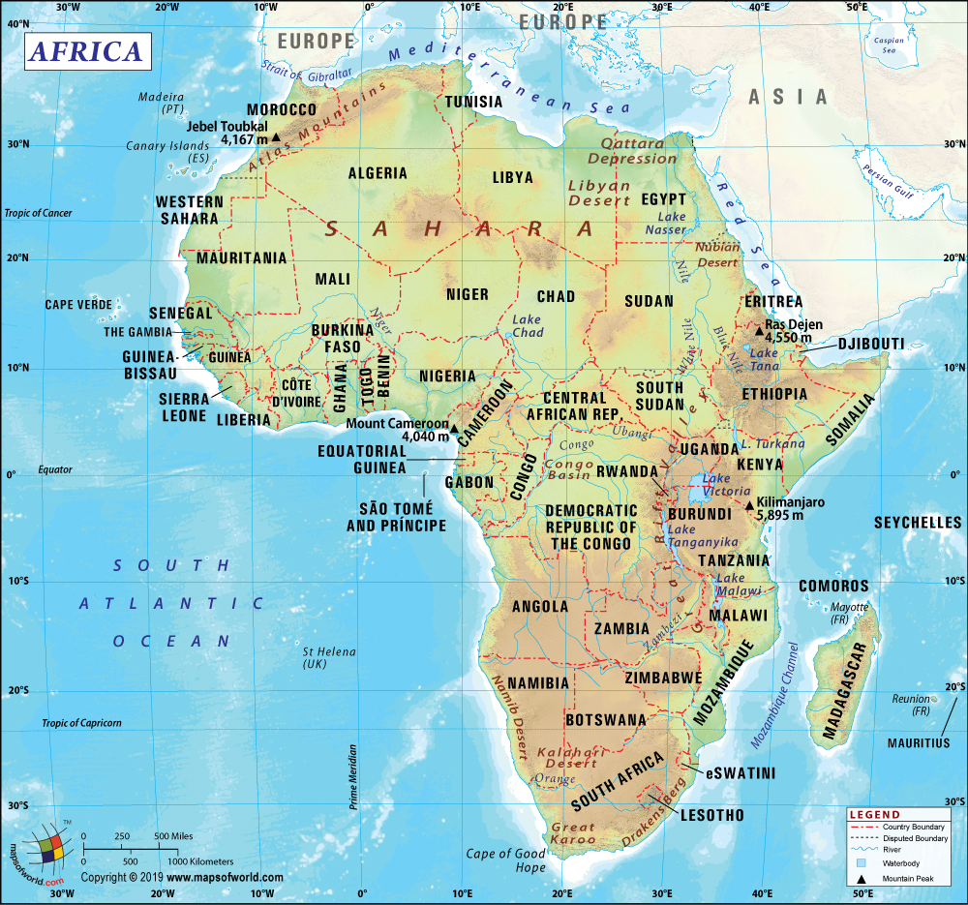




Issue 6 – Distribution channel model Africa – CELT
RECOMMENDATION
TARGET CITIES / CUSTOMERS
4
South Africa
Capetown
Durban
Johnesburg
CELT < 110 hrs
6
5
CELT < 78 hrs.
Egypt
4. Cairo
Kano
CELT < 24 hrs.
Nigeria
Lagos
Kano
CELT < 50 hrs.
Algeria
Algiers
3
1
2
Ref - https://www.goldsteinresearch.com/report/africa-two-wheelers-market-outlook-2024-regional-opportunity-assessment-and-demand-analysis-market-forecast-2016-2024

Slide 12
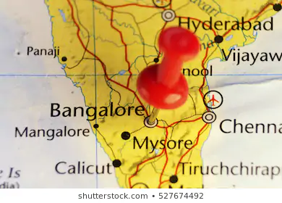
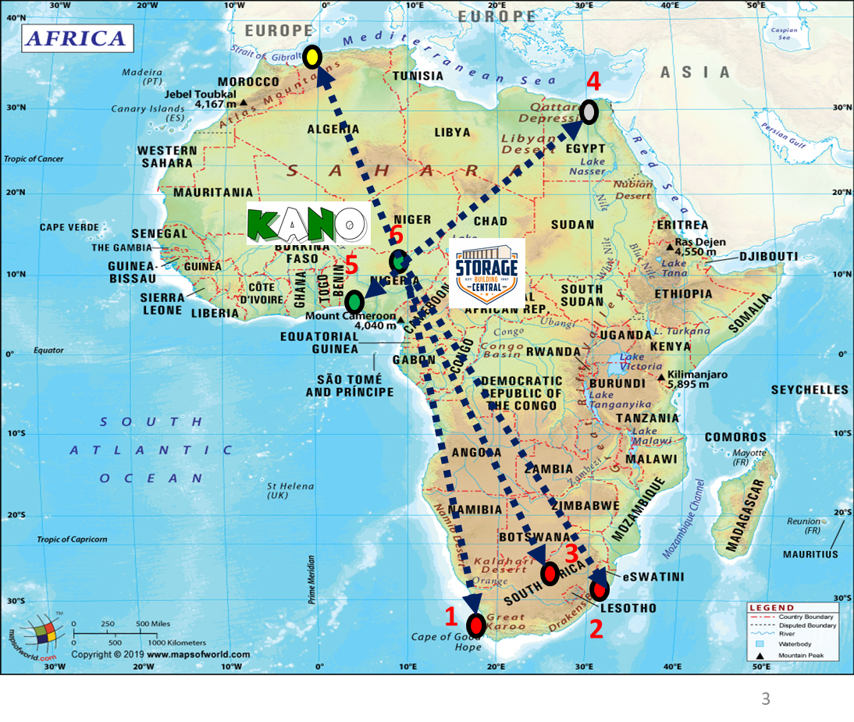
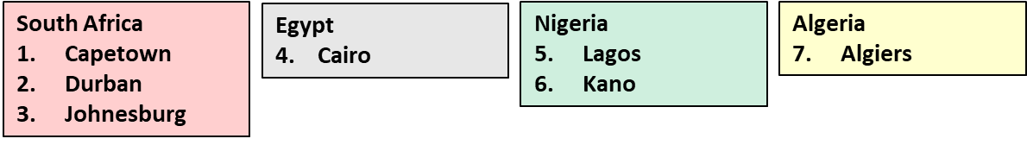





Issue 6 – Distribution channel model Africa
RECOMMENDED DISTRIBUTION NETWORK
“Distributor Storage with Carrier Delivery”
RECOMMENDATION
KANO @ Storage + Sales + Service
Ref – Supply Chain Management By Pearson – Sunil & Mendel

Slide 13
Issue 7 – Distribution channel model for India
The highest degree of complexity lies in the handling of pipes amongst all these commodities from logistics perspective………………………….
Ref

Slide 14
Issue 8 – Logistics Packaging issue
Logistics Packaging issue
The highest degree of complexity lies in the handling of pipes amongst all these commodities from logistics perspective………………………….
Ref

Slide 15
Issue 10 – India Operations challenges
Logistics Packaging issue
The highest degree of complexity lies in the handling of pipes amongst all these commodities from logistics perspective………………………….
Ref

Slide 16
Conclusion
1
2
3
4
5
6
7
8
9
10
The highest degree of complexity lies in the handling of pipes amongst all these commodities from logistics perspective………………………….
Ref

Slide 17
Thank you
Ref

Slide 18
Annexure
List of annexures
The highest degree of complexity lies in the handling of pipes amongst all these commodities from logistics perspective………………………….
Ref

Slide 19
Annexure -
http://www.mastermindofdenver.com/maintenance.html
The highest degree of complexity lies in the handling of pipes amongst all these commodities from logistics perspective………………………….
Ref

Slide 20
Annexure -
The highest degree of complexity lies in the handling of pipes amongst all these commodities from logistics perspective………………………….
Ref

Slide 21
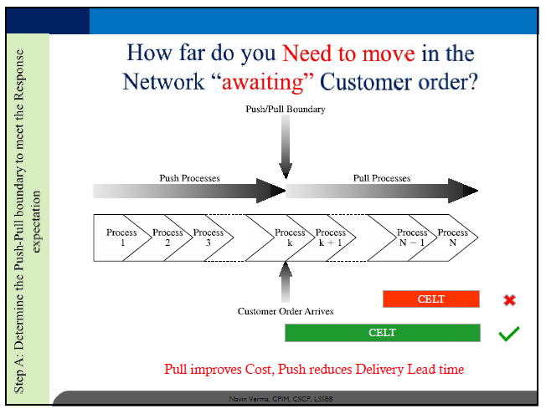
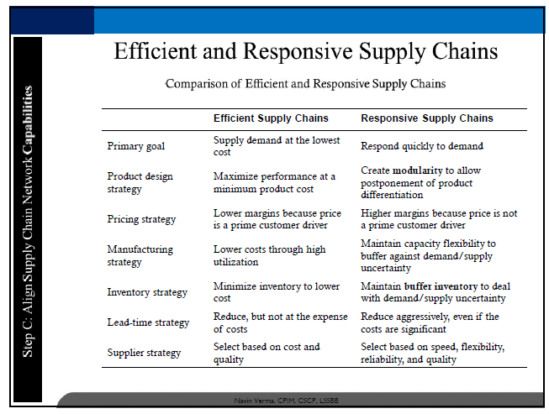
Annexure -
Reference
The highest degree of complexity lies in the handling of pipes amongst all these commodities from logistics perspective………………………….
Ref

Slide 22
